Slide 1


DevOps by examples
Giulio Vian
http://blog.casavian.eu/
giulio.dev@casavian.eu
@giulio_vian
http://www.getlatestversion.it/

Slide 2
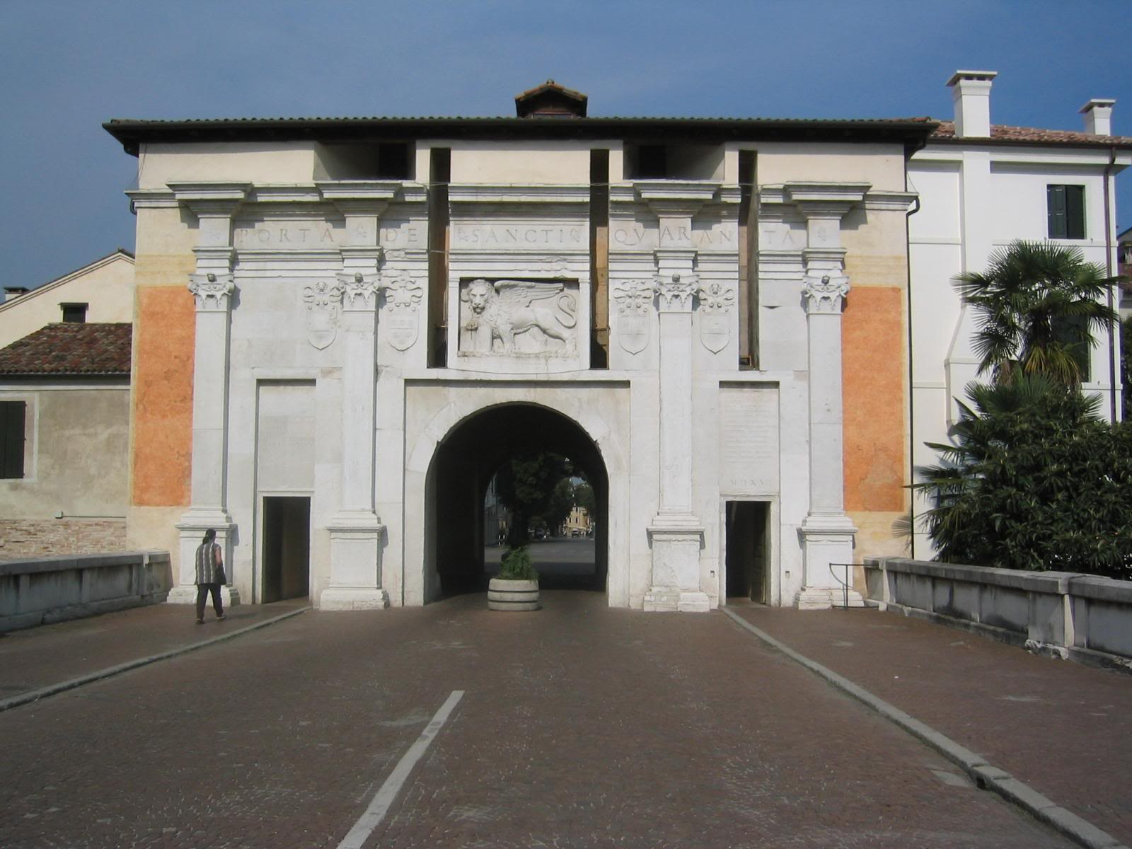

Qualcosa di personale
Origini
Presente

Slide 3
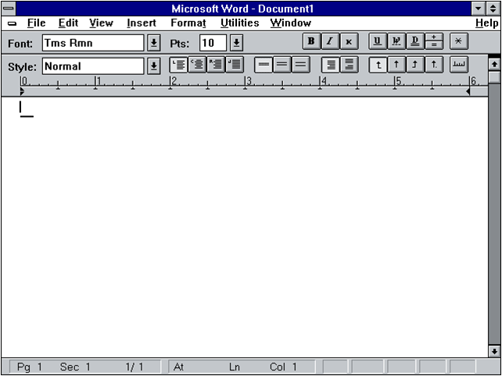




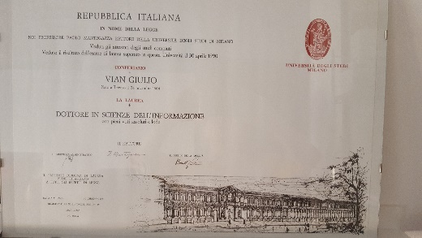


1990
Artel
1993
Freelance
2000
2014
1991
1995
AGT

Slide 4
What we will talk about?
DevOps?
Show me the code
Straightforward build and deploy
Add Configuration to the picture
Wrap-up
100/200-level session!

Slide 5
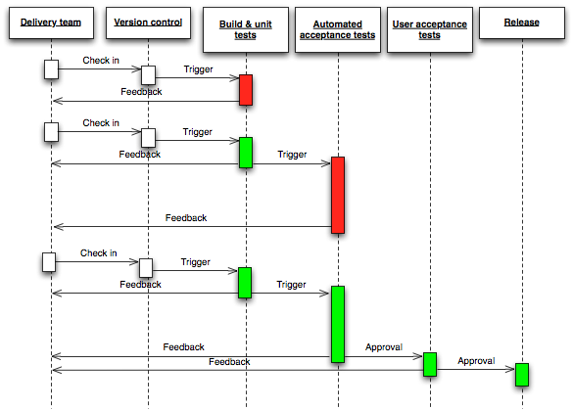
DevOps is a culture, movement or practice
Wikipedia
Not a technology
Not a tool
Continuous Delivery
Source: Jez Humble © 2010

Slide 6

Show me the code

Slide 7
0. Persone
Non gente, né risorse
Agile Manifesto

Slide 8
1. L’applicazione
Pagina web con dati da DB

Slide 9
2. Build & Package
Version Control
Continuous Integration
Artifacts

Slide 10
3. Running Environment

Slide 11
4. Infrastructure-as-Code
Declarativo o Imperativo
Version Control
Continuous Integration
Azure Resource Manager
Declarative Json-based
Extensible (script, DSC)
Entire infrastructure
AWS CloudFormation
Declarative Json-based
Ogni scarrafone…
Docker
Not much declarative
Single container
Ansible, Puppet, Chef, CFEngine, …

Slide 12
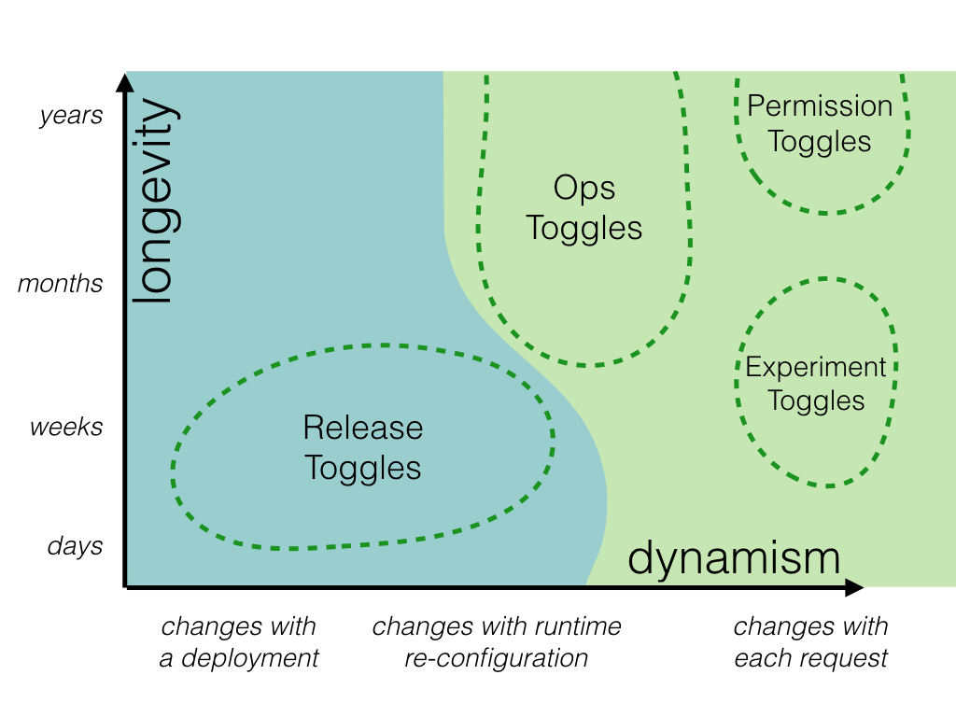
5. Deploy
Feature toggles
Source: Pete Hodgson
Notes:
http://martinfowler.com/articles/feature-toggles.html

Slide 13
6. Secrets
Build time
Sign
Deploy time
Credentials
Run time
Tokens
.gitignore
Centralized Version Control
Distinct repositories

Slide 14
7. Monitoring
Locale
Remoto
Aggregare
Filtrare
Application Insights
HockeyApp

Slide 15
8. Feedback loop
Prestazioni
Uso delle funzionalità

Slide 16
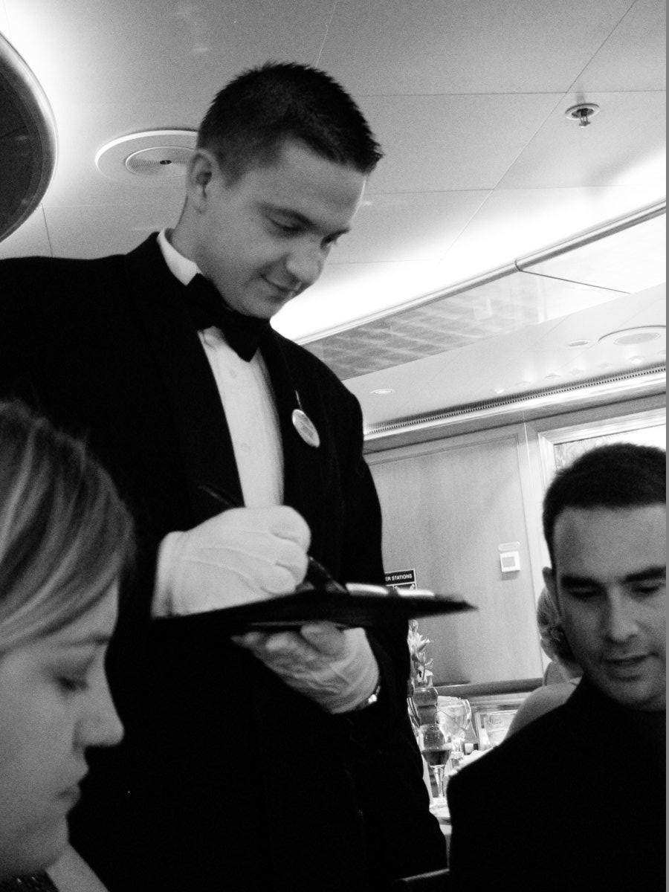
9. Persone

Slide 17
Bibliografia & Riferimenti
http://martinfowler.com/articles/feature-toggles.html
https://leanpub.com/build
https://launchdarkly.com/
http://www.slideshare.net/giuliov/presentations
http://agilemanifesto.org/
https://azure.microsoft.com/en-us/services/application-insights/
https://github.com/tfsaggregator/tfsaggregator

Slide 18
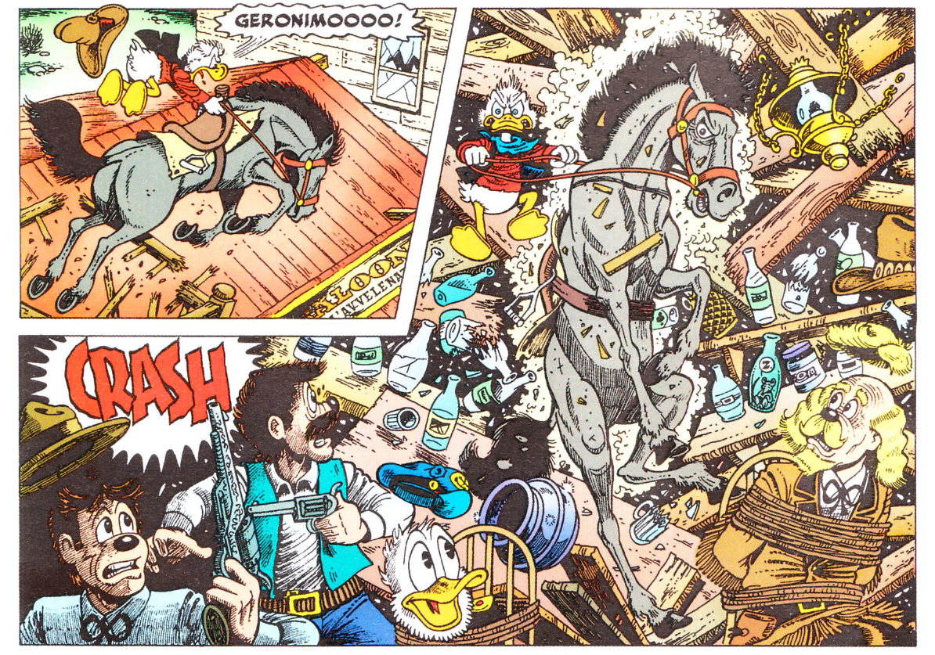
Call to action

Slide 19

Fine delle trasmissioni

Slide 20
Backup slides
Notes:
Nota con VSTS cloud non significa pubblico!

Slide 21
Environments
Dev test
Integration
Production
QA
Staging
Laboratory
Production

Slide 22
Rollout dimensions
Timeframe
Less then a week
One week
One month
A few month
Patch
Module
Application
System
Size

Slide 23
Rollout by steps
Database tier
Application tier
Presentation tier
Database tier
Application tier
Cllient
Mainframe
Service tier
Web

Slide 24
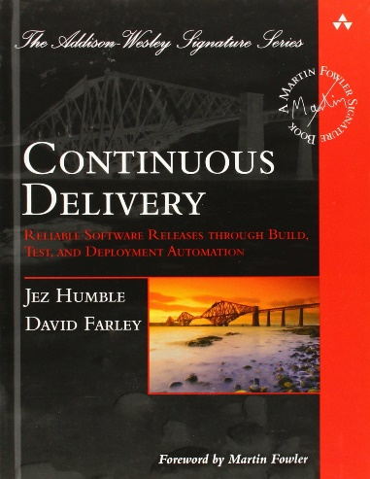
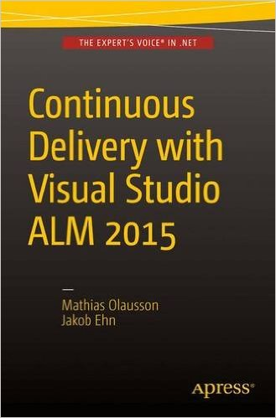
To know more
Continuous Delivery: Reliable Software Releases through Build, Test, and Deployment Automation — J.Humble, D.Farley (Addison-Wesley)
https://www.amazon.it/Continuous-Delivery/dp/0321601912/
Continuous Delivery with Visual Studio ALM 2015 — M.Olausson, J.Ehn (Apress)
http://www.amazon.it/Continuous-Delivery-Visual-Studio-2015/dp/1484212738/

Slide 25



Who am I?
Veneto (Italia, Europe)
25 years experience
Long years at
Currently at
Known for TfsAggregator2
If I do not speak English (or sounds weird to you) stop me
Notes:
https://github.com/tfsaggregator/tfsaggregator
http://www.radiotfs.com/Show/105/TFSAggregator2withJesseHouwing

